Slide 1

VOICE DEVICE CONTROL
VOICE DEVICE
CONTROL
Instructors : M.S.Tran Thi Tra Vinh
Members : Le Duc Nhat
: Le Thien Nhan
Class : 19CE

Slide 2
TABLE OF CONTENTS
01
02
03
04
05
06
Reason
Target
Technology
Result and Development
System design
Model building

Slide 3

REASON
O1

Slide 4

01. REASON
1
2
3
Realizing the development of the growing IoT industry, exchanging data through the Internet
Most people now use smartphones and remote controls
Smart technology devices are increasingly developing while taking advantage of voice to manage devices easily.

Slide 5

Target
O2

Slide 6
Target
-01-
-02-
Build successful models with intelligent voice control
Development of control of devices through mobile application
-03-
-04-
Good foundation to aim for big goals and develop
Put the model into practice and use

Slide 7

Technology
O3

Slide 8


01
03 . Technology
Android - App
Kotlin – Java – C++
02
Sever
Firebase
03
Voice
Google Assistant

Slide 9

O4
System design

Slide 10
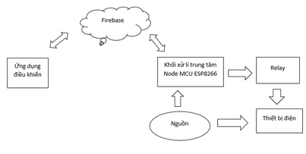
04. System design
01. System block diagram

Slide 11
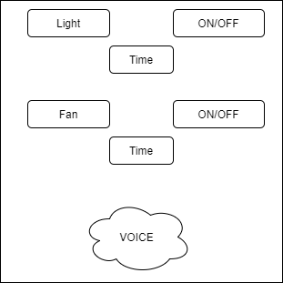
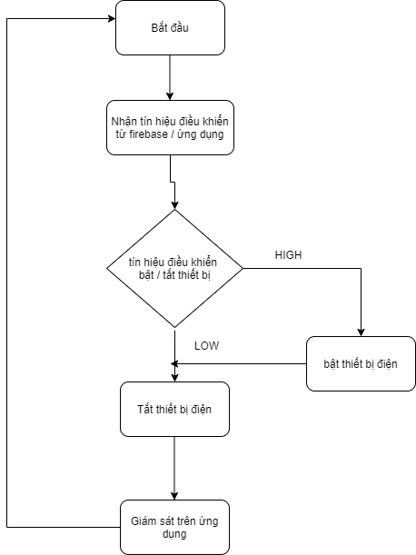
02. Control application
03. Algorithm flowchart

Slide 12
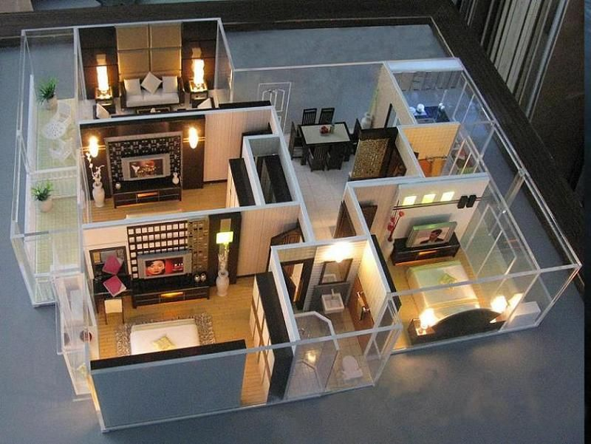
05
Model building

Slide 13
05. Model building
Development
Control circuit
Use wifi module to read data from firebase
Setup wifi connection and firebase connection
module ESP8266 NodeMCU, module relay 4 kênh, đèn 220V, quạt 12V, dây bus, pin.
#include <ESP8266WiFi.h>
#include <FirebaseESP8266.h>
get the firebase URL we put in the Database Realtime Database

Slide 14
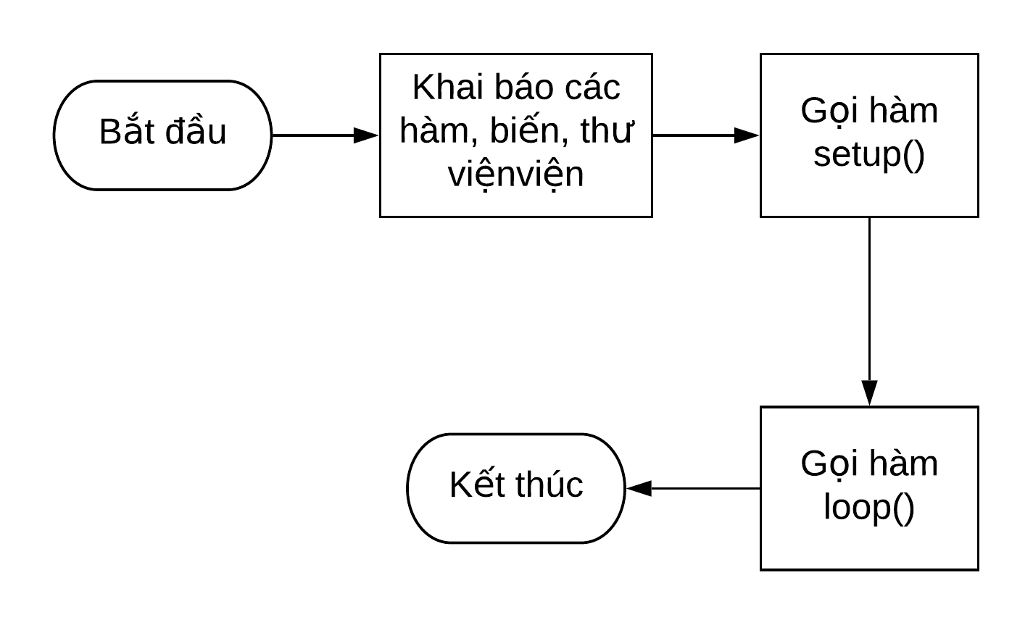
Flowchart of a program in the Arduino IDE

Slide 15
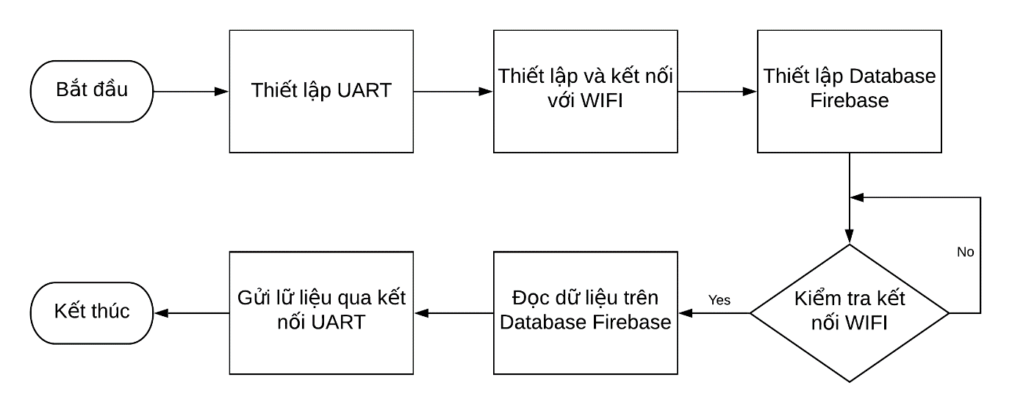
Flowchart wifi module

Slide 16

Result and Development
06

Slide 17
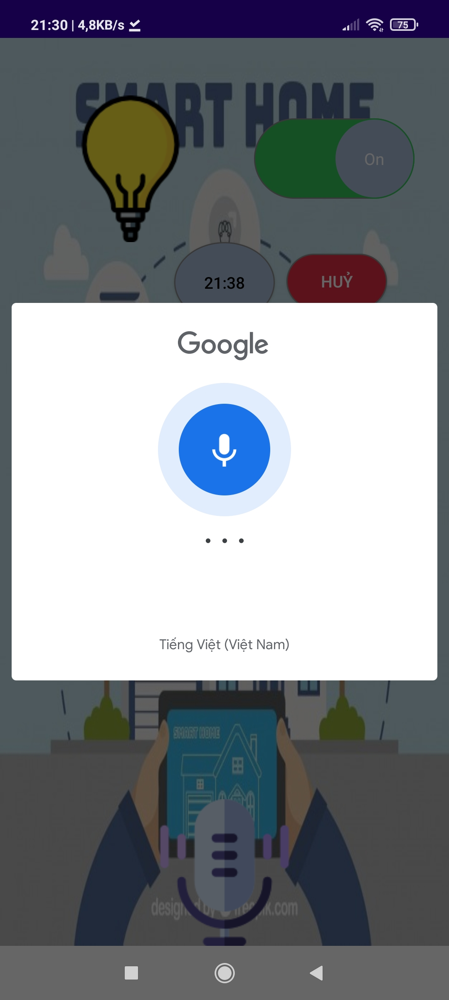
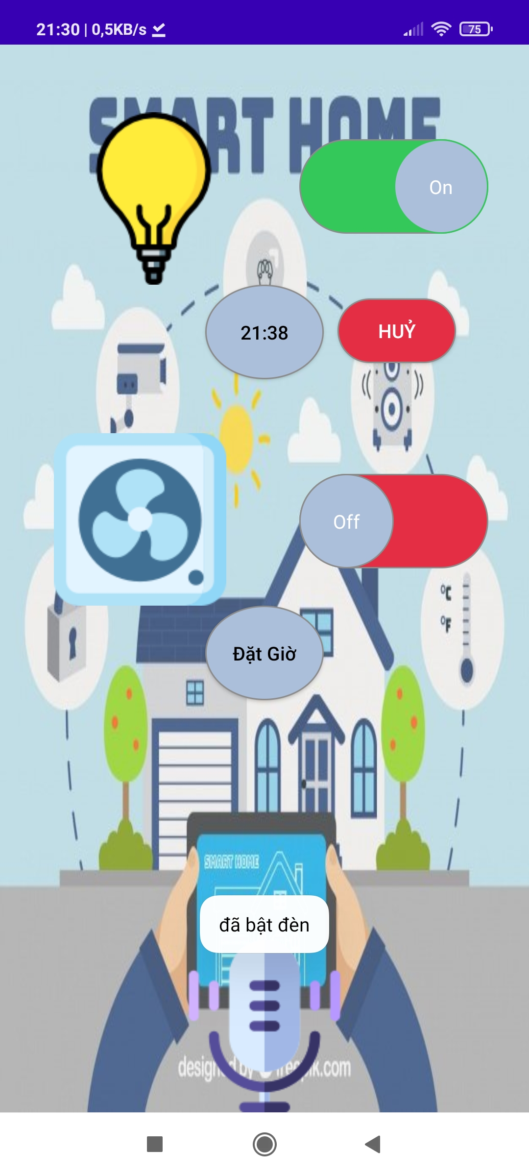
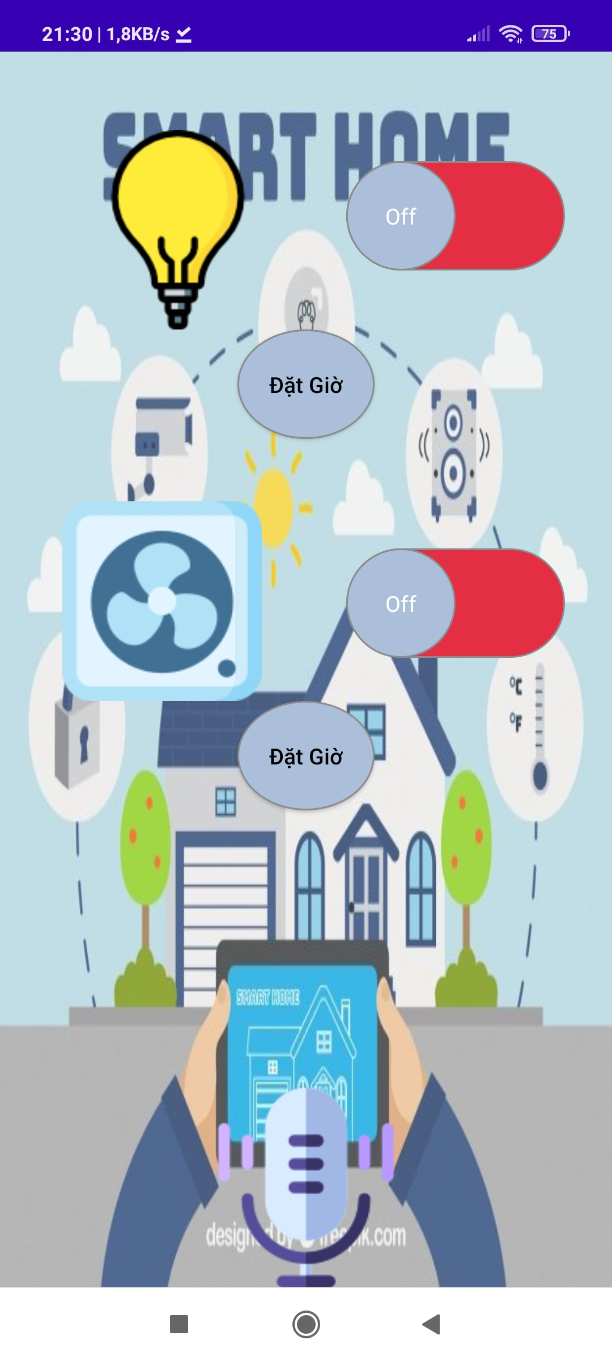
06. 1- Result
Application interface

Slide 18

2021
2022
2023
2024
2025
06. 2- Development
Overcome errors in the system
Expanded system
Development on multiple devices easy to use and manage

Slide 19
Thank you for listening

